Slide 1

Doc2Vec network in Tensorflow
Students: Arzu Fatullayeva
Sokrat Bashirov
Course: Neural Networks & Deep Learning

Slide 2
Agenda
Introduction to Word Embeddings
Understanding Doc2Vec
Components of Doc2Vec Implementation
About Dataset
Text Preprocessing
Model Architecture
Training Process
Evaluation and Validation
Example Demonstration
Conclusion

Slide 3
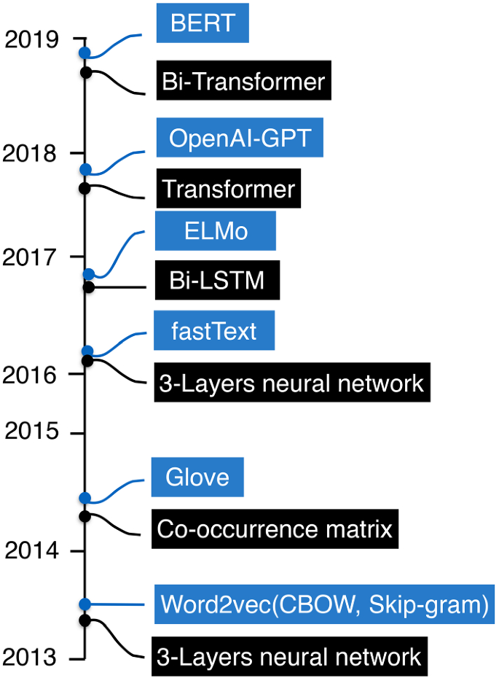
Word Embeddings
The dense vector representations of words in a continuous vector space.
Motivation: The ability to capture semantic relationships between words.
Models: Word2Vec, GloVe, FastText, TF-IDF, Bag-of-words, BERT.

Slide 4
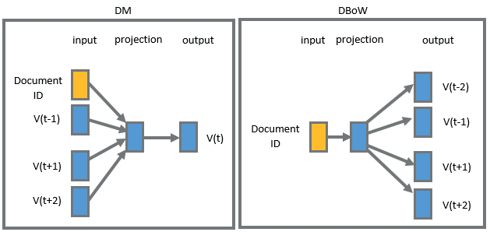
Understanding Doc2Vec
An extension of word embeddings that was introduced to capture not only the meaning of individual words but also the context and relationships within entire documents.
Doc2Vec represents documents as fixed-size vectors in a continuous vector space.
The strengths of Doc2Vec lies in its ability to consider the context of words within the document.

Slide 5

Components of Doc2Vec Implementation
normalize_text
build_dictionary
text_to_numbers
generate_batch_data
load_movie data
PV-DM
train
Movie review
dataset
Data Loading
Model Architecture
Evaluation and validation
Data preprocessing

Slide 6
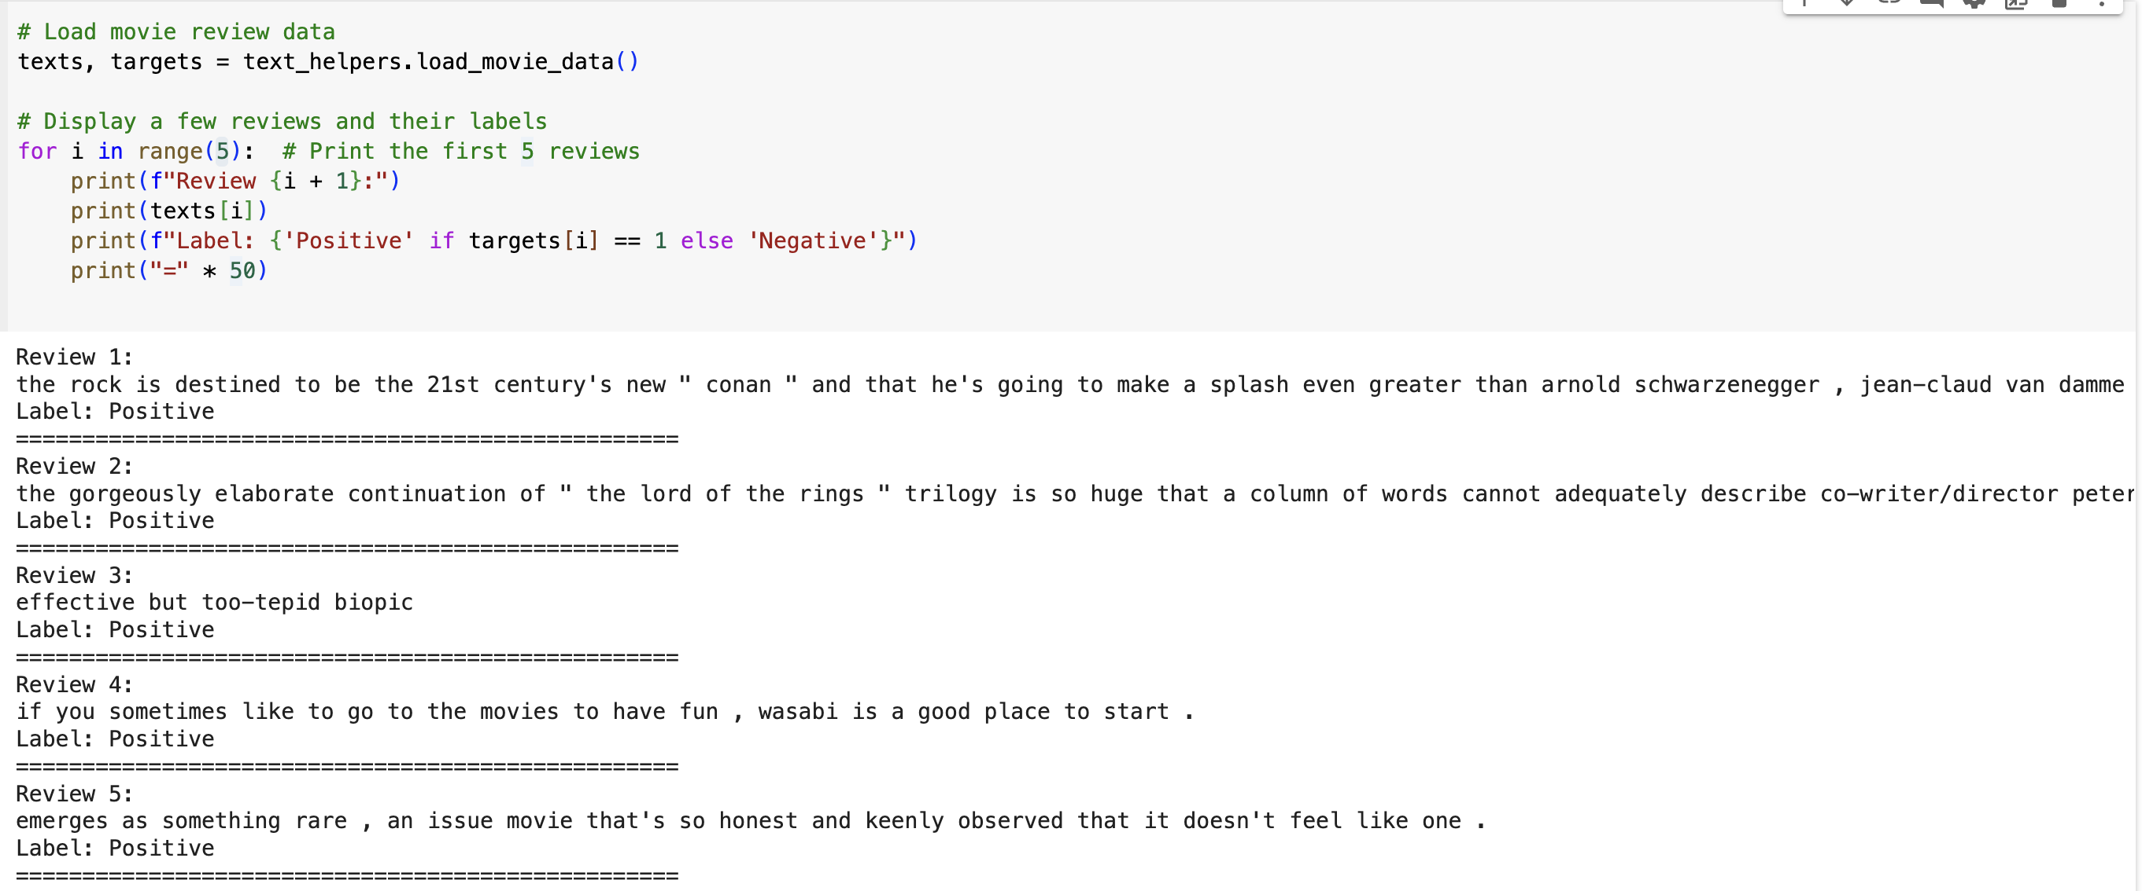
Dataset
Notes:
Two data files used in the experiments. These files are rt-polarity.pos, containing 5331 positive snippets, and rt-polarity.neg, containing 5331 negative snippets.
Each line in these files corresponds to a single snippet, usually a sentence, and all snippets are in lowercase.

Slide 7
Text Preprocessing
Normalizing Text
Lowercase, punctation, numerical characters, stopwords
Building a Dictionary
This dictionary maps words to unique integer indices
Converting Text to Numbers
convert the normalized text data into lists of integers according to the word dictionary
Selecting Validation Words
These words are used later to validate the model during training

Slide 8
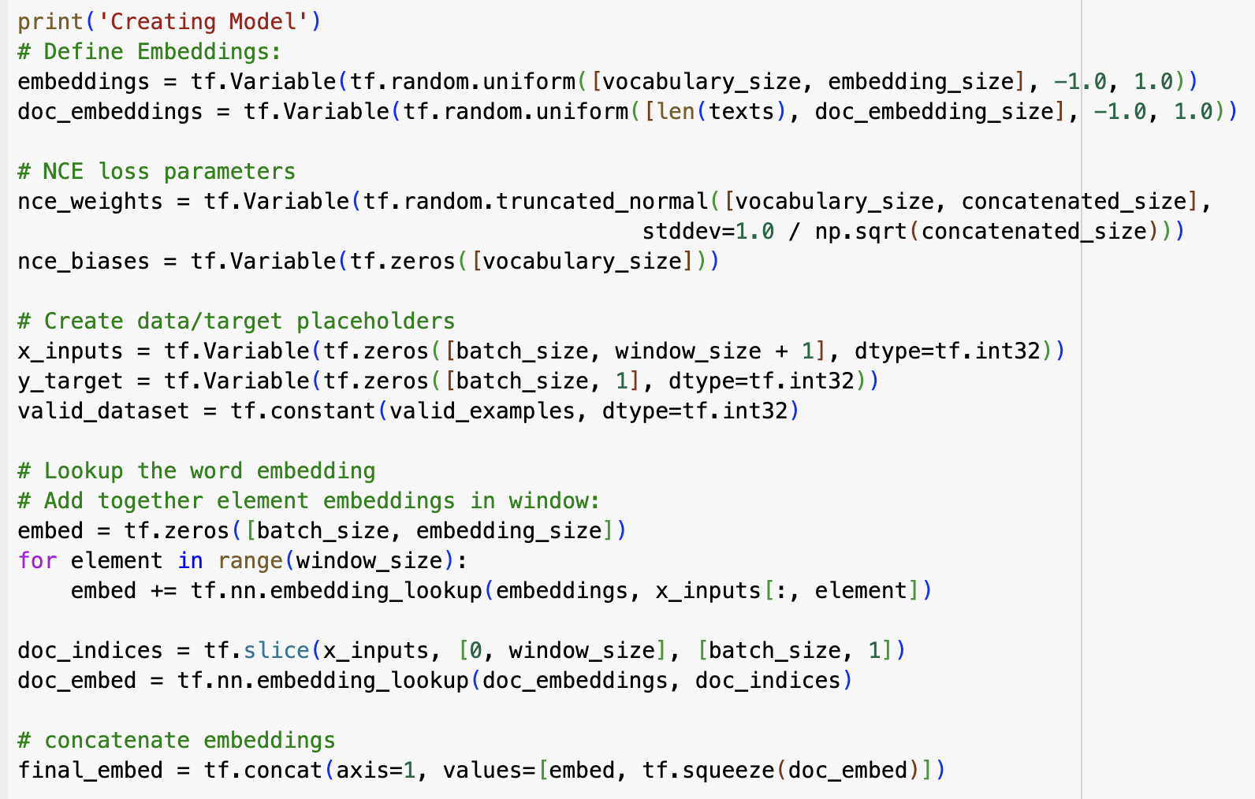
Model Architecture PV-DM
Concatenation of Word and Document Embeddings

Slide 9
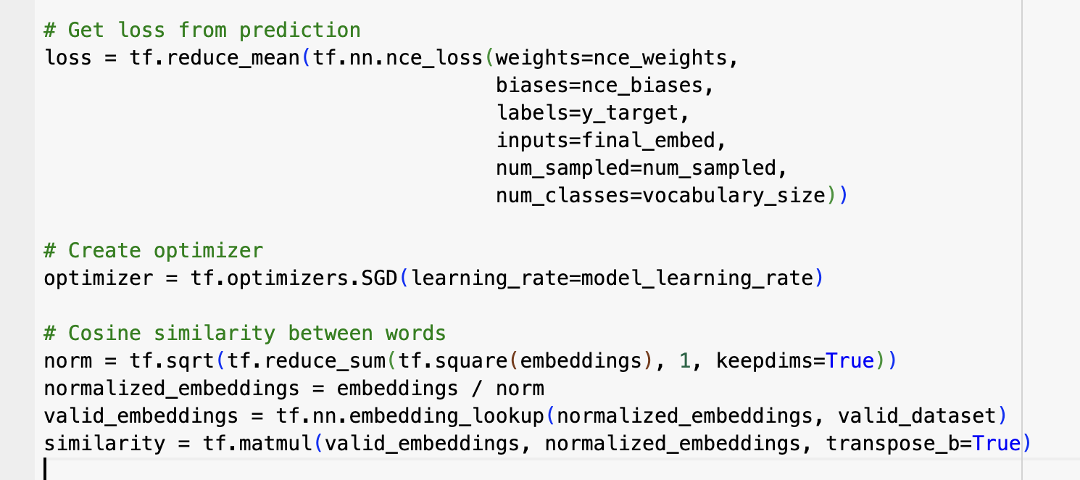
Model Architecture PV-DM
loss function, optimization function, cosine similarity

Slide 10
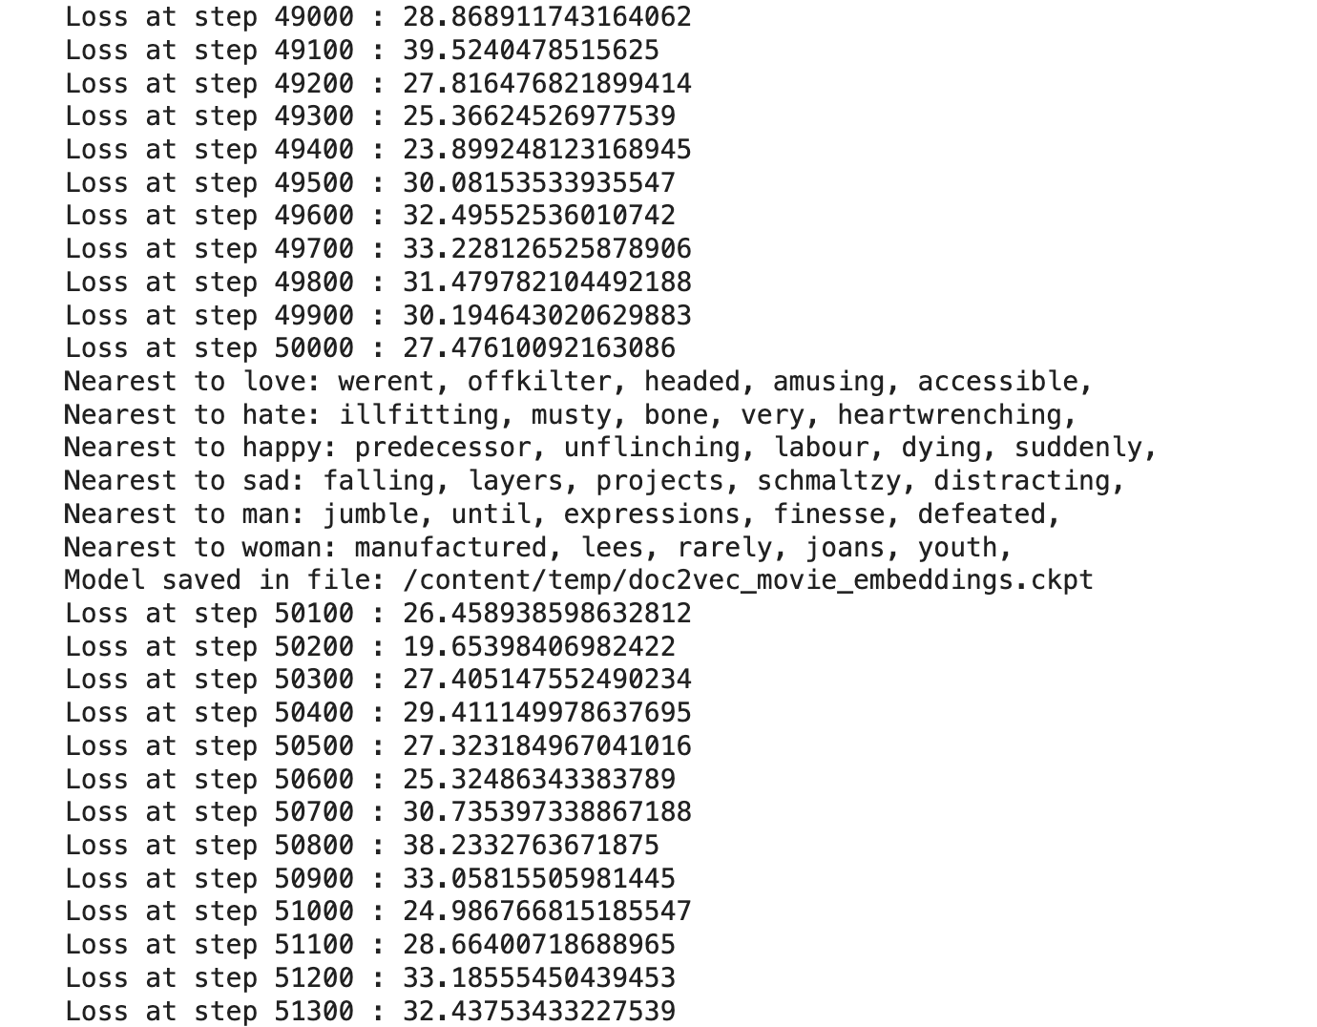
Example Demonstration
"Loss at step X : Y" indicate the training progress.
The loss value represents how well the model is performing, with lower values indicating better performance.
Every 5000 steps, the model outputs the nearest words to a set of predefined validation words (like "love", "hate", "happy", etc.). This is done to check the quality of the word embeddings. The nearest words are found using cosine similarity in the embedding space.

Slide 11
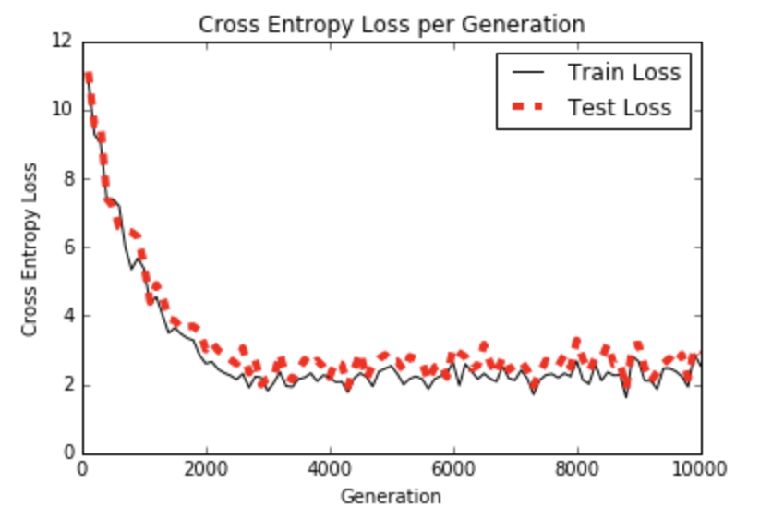
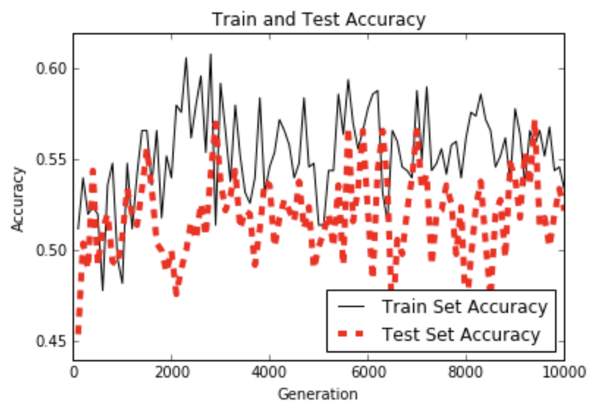
Evaluation and Validation

Slide 12
References:
https://medium.com/@evertongomede/doc2vec-understanding-document-embeddings-for-natural-language-processing-ba244e55eba3
https://www.geeksforgeeks.org/doc2vec-in-nlp/
https://medium.com/wisio/a-gentle-introduction-to-doc2vec-db3e8c0cce5e
https://medium.com/nlplanet/two-minutes-nlp-11-word-embeddings-models-you-should-know-a0581763b9a9

Slide 13
Thank you for attention!

